Slide 1
Stephan v.d Westhiuzen
Data Visualisation Assignment
24/08/2017

Slide 2
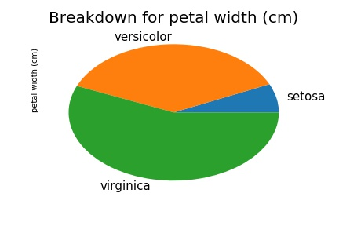
Pie Charts
Offers the reader to see the data very clearly
Gives the same insights as looking at numbers would

Slide 3
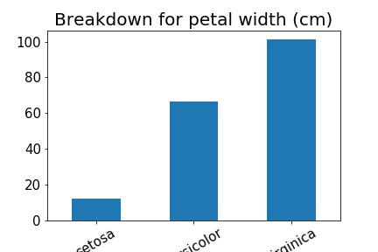
Bar Charts
Conveys information just as well as a pie chart
The difference between two datasets is clearer

Slide 4
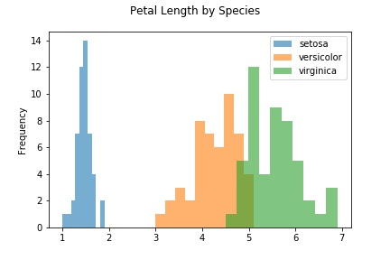
Histograms
Conveys the data distribution quite well
Clearly differentiates between datasets

Slide 5
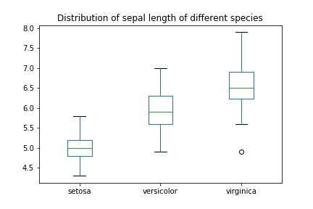
Box Distribution Charts
Summarizes the data by showing the data distribution clearly
Extreme values are clearly depicted

Slide 6
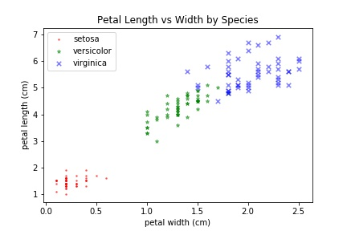
Scatterplots
Can indicate relationships within a dataset

Slide 7
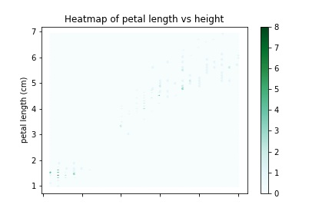
Heat Maps
Heatmaps are used to see how many data points overlap each other

Slide 8
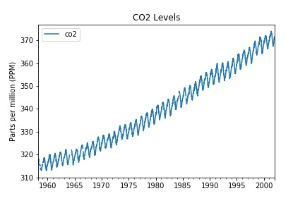
Time Series Charts
One of the most important type of plots
Clearly indicates the relationship to time
Trends can sometimes be seen from a time series

